Slide 1
Matrices
Impact Based Forecasting
October 2015

Slide 2
Why do we need a Hazard Matrix?
All hazards approach to better coordinate emergency preparedness and response
Include potential for subsequent or secondary emergencies
Hazards can have primary, secondary and tertiary effects

Slide 3
Hazard definitions
Hazard: a meteorological or geophysical event which has the potential to negatively impact on humans, animals or the environment. E.g., Cyclone
Primary: occur as a result of the process itself. E.g., rainfall
Secondary: occur because primary hazard has caused them. E.g., Flooding
Tertiary: Occur as a result of primary and secondary hazards and often have long term effects. E.g. loss of livestock leading to poverty or migration

Slide 4
Hazard Matrix Example
Source | Primary Hazard | Secondary Hazard | Tertiary Hazard
Monsoon | Strong winds Heavy rainfall Thunderstorms | River and coastal flooding Surface water flooding Land instability | Disease

Slide 5
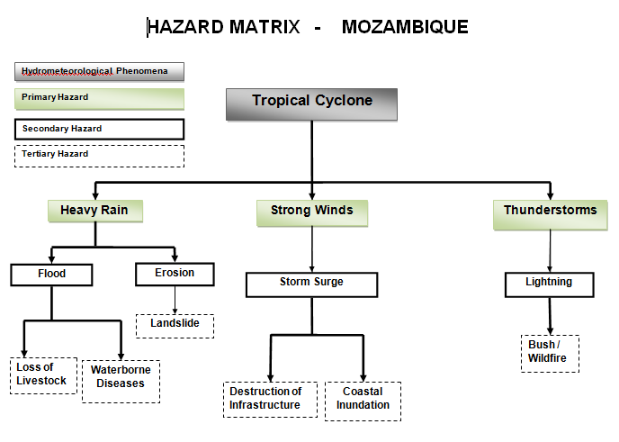
Alternative Hazard Matrix

Slide 6
Introduction to Impact Matrices
Impact matrix allows organisations to decide where on the risk matrix an event lies for a specific event
Is the bad weather expected during a rush hour?
In the area of concern are there any local “hot-spots” i.e. areas prone to the particular weather hazard (wind, snow, fog, flooding etc.)
Are there any significant outdoor events at which large numbers of people could be adversely affected?
Are there “politically” sensitive areas e.g. areas which have flooded badly recently?

Slide 7
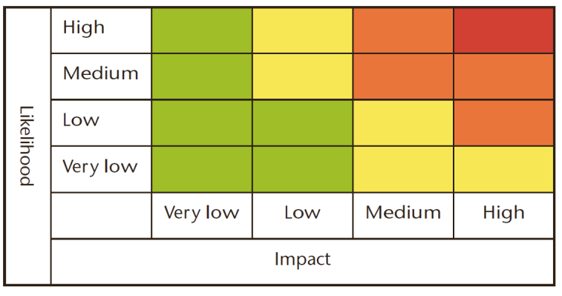
Where is the tick?
YELLOW
✓
High Likelihood - Low Impact
The public should be aware that some minor disruption is highly likely.
Low Likelihood - High Impact
Some very severe conditions are possible with major disruption to daily life (particularly to…) and the public should be prepared.
✓

Slide 8
Methodology
For each identified hazard, each sector should determine the impacts
Impacts should be categorised into minimal, minor, significant and severe

Slide 9
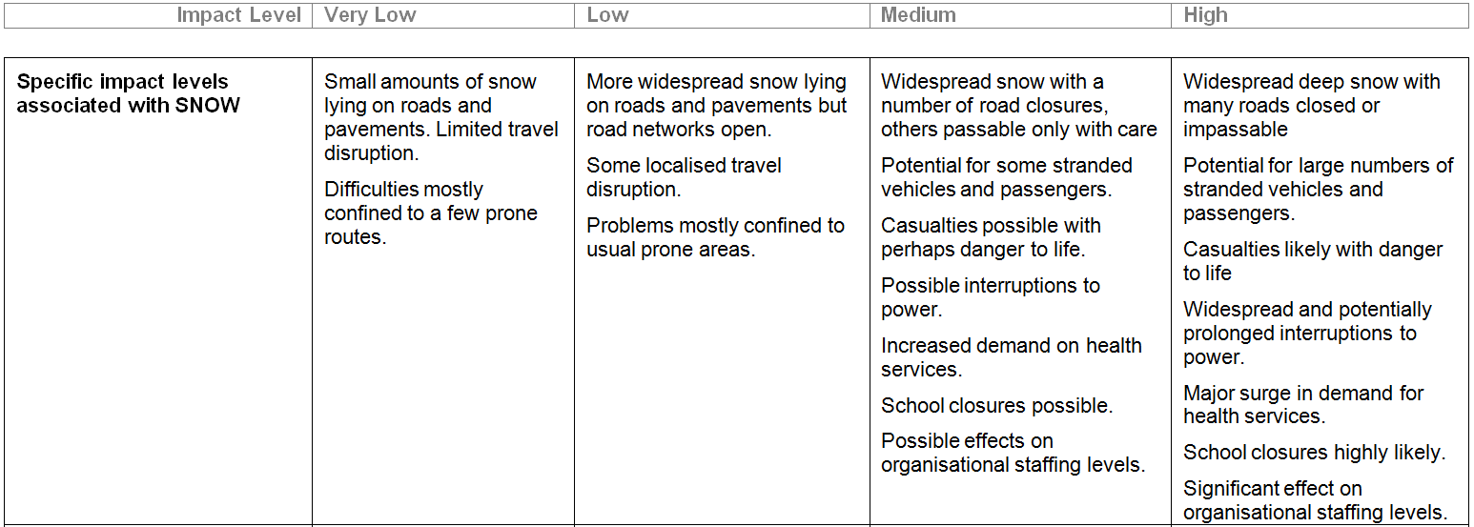
Impact Matrix Example

Slide 10
Mitigation Advice Matrix
Know Impact level as well as likelihood – gives us a Risk level
But what now?
Advice matrix for each hazard with advice on what actions need to be taken in order to reduce impact
Separated into Risk levels: Very Low, Low, Medium, High

Slide 11
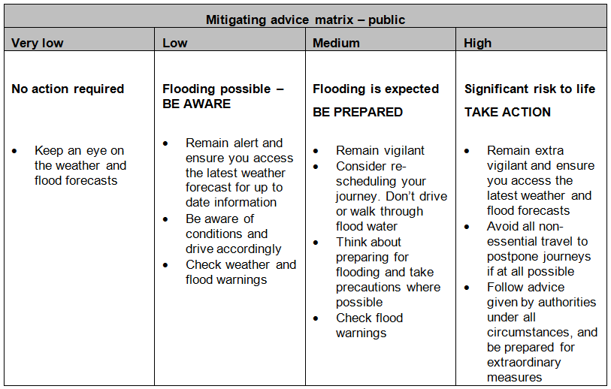
Mitigation Advice Matrix Example

